Slide 1




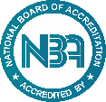


An Autonomous Institution
Department of Artificial Intelligence And Data Science Engineering
21EE05P - PROJECT PHASE REVIEW - ZEROTH / I / II
Smart Expense Visualizer With ML Insights
Biotech,
Chemical,ECE &IT
PRESENTED BY
VH13847 Mark Jerome Raj P - 113024243080 - III Sem
VH13848 Mohamed Nowfal M - 113024243082​ - III Sem
VH13859 Nishanth Kumar B - 113024243097 - III Sem
Supervisor Ms.Kuppulakshmi | Head of the Department Mrs.Geetha
Date: 10.08.2025

Slide 2
PROJECT STRUCTURE
The proposed project work consisting of the Chapters as follows.
Chapter 1: Introduction
Chapter 2: Objective
Chapter 3: Tech Stack
Chapter 4: Modules Description
Chapter 4: Literature Survey
Chapter 5: Architectural Diagram
Chapter 5: Advantages And Disadvantages
Chapter 6: Conclusion And References

Slide 3
INTRODUCTION
Managing finances is a daily challenge in today's digital world.
Manual tracking is time-consuming and error-prone.
Our solution is a smart, integrated tool to simplify expense tracking.
Leverages modern tech: OCR, data visualization, and ML.

Slide 4
OBJECTIVE
Enable bill scanning using OCR.
Classify expenses into categories.
Visualize trends over days, months, and years.
Provide insights using ML like future spend prediction.
User-friendly interface with minimal input effort.

Slide 5
Software Requirements:
Language: Python
OCR: Tesseract / OpenCV
ML insights : scikit-learn
Visualization: matplotlib, seaborn
DB: SQLite or CSV
GUI: Streamlit / Tkinter / Flask
Tech Stack
Hardware Requirements:
- Laptop/PC Webcam ( for direct scanning)
- Camera

Slide 6
Modules Description
User Input Interface:- Manual or scanned input with validation.
OCR Integration:- It Uses Tesseract OCR to parse bill details.
ML Module:- Predict future spend using regression or time series.
Visualization:- Pie charts, bar graphs, heatmaps using matplotlib/seaborn.

Slide 7
Literature Survey
1.Existing Expense Tracking Apps:
Popular apps like Mint, Wallet, and Money Manager support manual logging and basic category-wise analysis. However, they often lack features like automation, intelligent categorization, and smart insights.
2. OCR in Financial Applications:
OCR tools such as Tesseract are effective for extracting data from receipts and bills. They reduce manual entry but struggle with inconsistent formats and lack deeper integration in expense trackers.
3. Speech Recognition for Logging:
Speech recognition tools like Google Speech API and CMU Sphinx enable voice-based input, improving speed and ease of use. Yet, they are rarely utilized for financial data entry in consumer apps.

Slide 8
4. Machine Learning in Categorization:
ML algorithms like Decision Trees, KNN, and SVM have proven effective in automatically classifying expenses based on user behavior, offering more accurate results than rule-based systems.
5. Data Visualization & Insights:
Visualization tools such as matplotlib, Seaborn, and Power BI provide clear insights through charts and graphs, enhancing user understanding and decision-making.
6. Research Gap:
There is a clear lack of unified platforms that combine OCR, voice input, ML-based categorization, cloud sync, and interactive visual analytics. This gap is what our proposed system aims to fill.

Slide 9
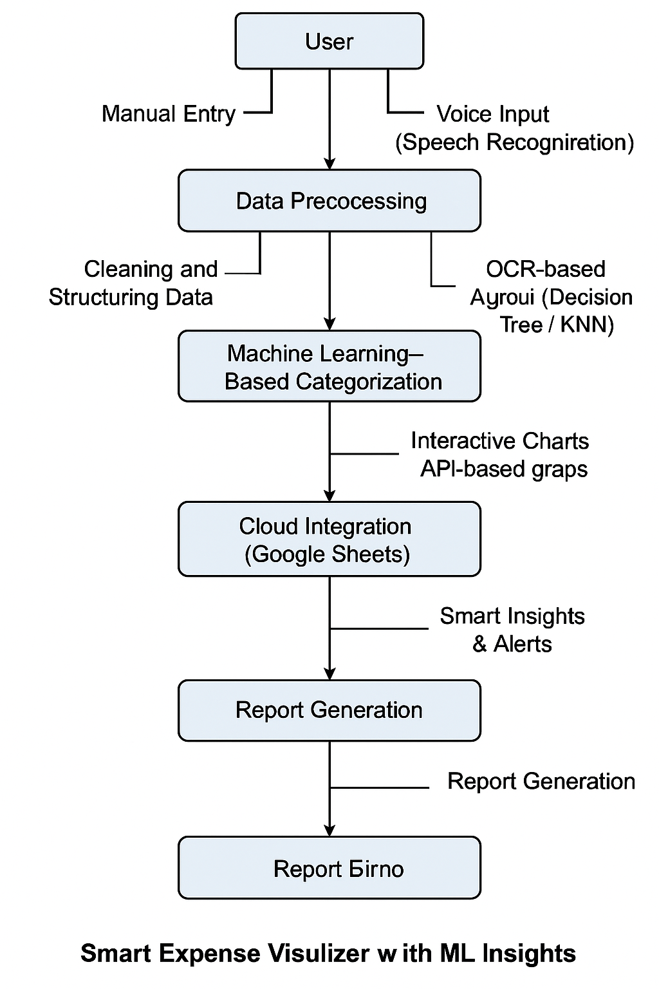
Architectural Diagram

Slide 10
Advantages And Disadvantages
Advantages:
Enables expense logging via voice, OCR, and manual input.
Reduces manual work through automation.
Uses machine learning for smart expense categorization.
Syncs data in real-time using Google Sheets.
Provides clear financial insights through charts.
Sends alerts when budget limits are crossed.
Allows exporting reports in PDF/Excel formats.
Disadvantages:
1.OCR and voice input may sometimes misinterpret data.
2.Requires internet for full functionality.
3.Machine learning needs proper training data.
4.Cloud storage raises potential privacy concerns.

Slide 11
Conclusion
The Smart Expense Visualizer with ML Insights offers an efficient, automated solution for modern expense management.
By combining OCR, voice input, machine learning, and visual analytics, it reduces manual effort, improves categorization accuracy, and provides users with meaningful financial insights.
The system is scalable, user-friendly, and aligns with the growing need for intelligent personal finance tools.

Slide 12




References
Tesseract OCR
https://github.com/tesseract-ocr/tesseract
scikit-learn
https://scikit-learn.org/stable/
Matplotlib
https://matplotlib.org/
IEEE & Elsevier Financial Journals

Slide 13

Thank you
*

